Slide 1
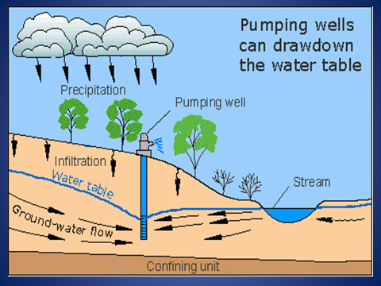
Complete all 11 tasks
Water Distribution Notes
Key Vocabulary
Fill in the meaning below
9. What happens if toxins get into a Watershed? Explain
_____________________________________________________________________________________________________________________________________
http://bit.ly/waternotes
1. Surface Water- all the bodies of fresh water, salt water, ice, and snow that are found above the ground
2. Hydroelectric power-electrical energy produced by flow of water
3. Tributaries-rivers or streams flowing into a larger river or lake
4.Watershed-the area of land that is drained by a water system
5. Groundwater-that water that is beneath the Earth’s surface
6. Water Table-upper level of an underground surface in which the soil or rocks are permanently saturated with water.
7. Aquifer-a body of rock or sediment that stores underground water and allows the flow of groundwater
8. Well-structure created in the ground by digging, driving, boring, or drilling to access groundwater in underground aquifers
10. Draw the cone of depression above

Slide 2
Acid Rain

Slide 3
What is acid rain (precipitation)?
Precipitation such as rain, sleet, or snow that contains a high concentration of acids.

Slide 4
How is it caused?
When fossil fuels are burned they release oxides of sulfur and nitrogen.
Oxides mix with water in the atmosphere and form sulfuric acid and nitric acid, which fall as acid precipitation.

Slide 5
How does acid rain affect soil and plants?
Acid rain drops the pH of soil and water.
When soil pH becomes more acidic some nutrients are dissolved and washed away.
Other toxic metals are released and absorbed by plants

Slide 6
How does acid rain affect aquatic ecosystems?
If the water’s pH is changed fish and other aquatic animals will die.

Slide 7
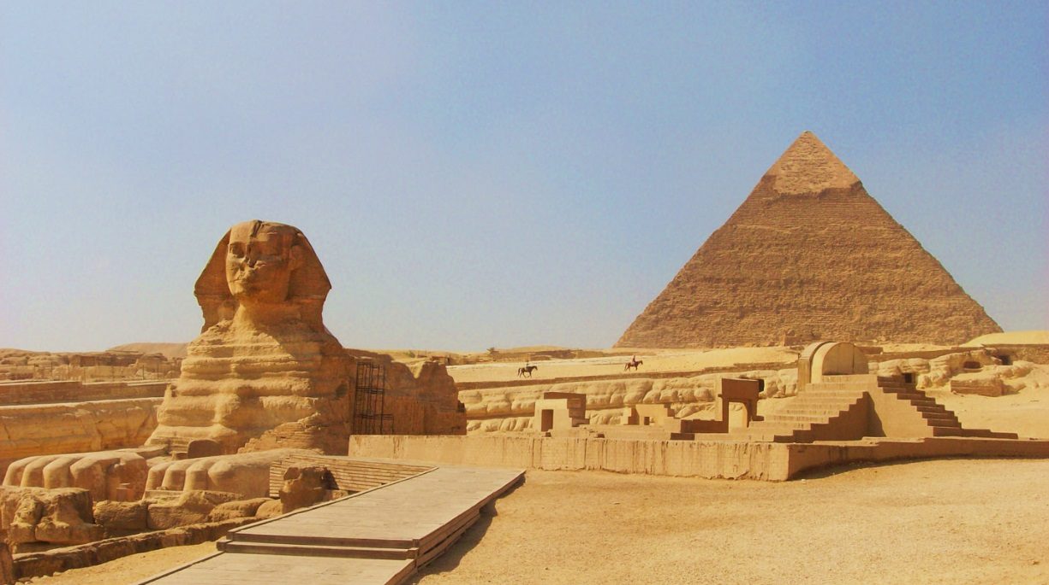
How does acid rain affect humans?
We can be poisoned by water, fish or crops that have absorbed toxic metals.
Dissolve building materials (concrete, marble, limestone)
Ex. Acropolis in Greece, Taj Mahal in India, pyramids in Egypt

Slide 9
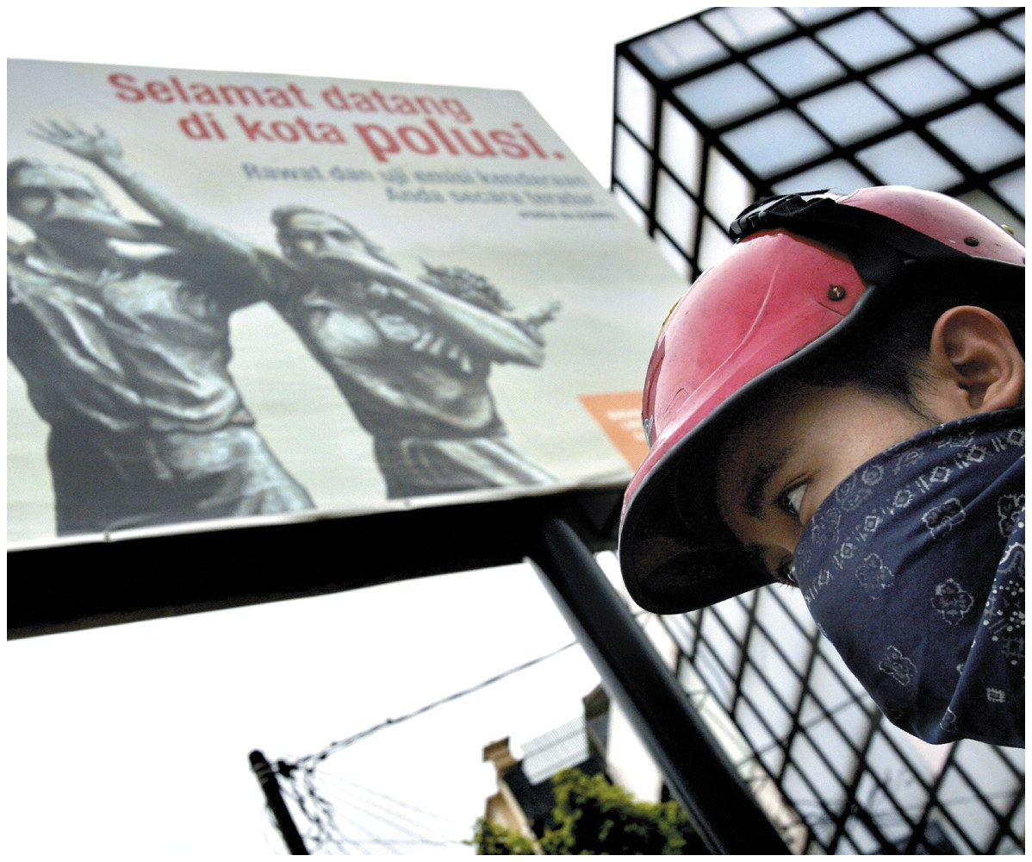
Air Pollution

Slide 10
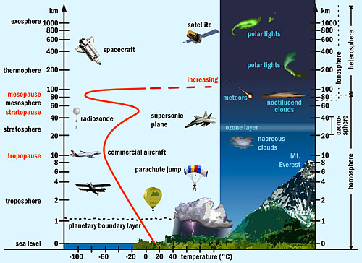
Layers of the Atmosphere

Slide 11
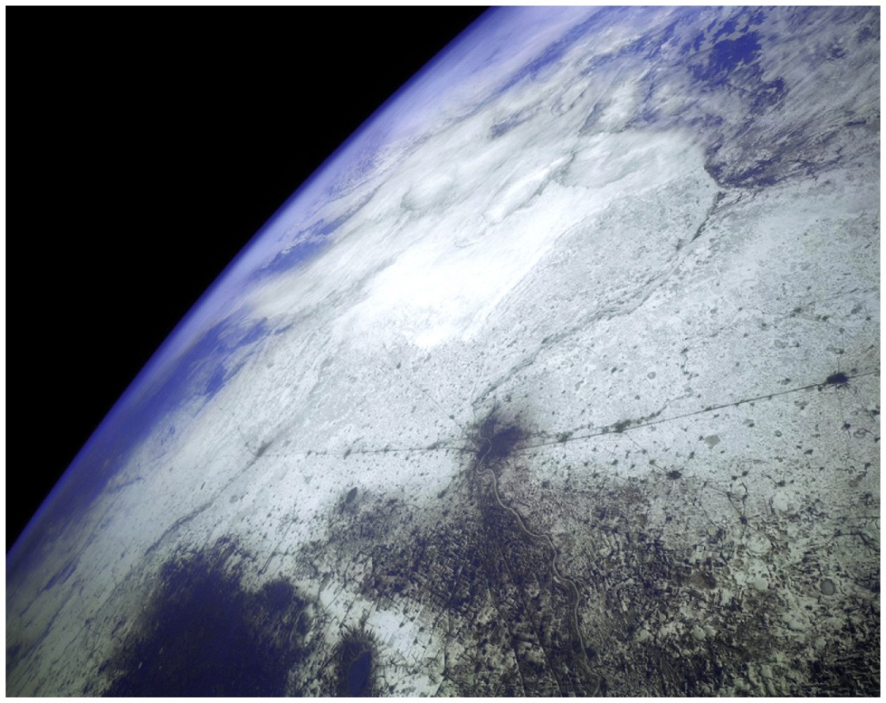
Atmosphere as a Resource
Atmospheric Composition
Nitrogen 78.08%
Oxygen 20.95%
Argon 0.93%
Carbon dioxide 0.04%
Ecosystem services
Blocks UV radiation
Moderates the climate
Redistributes water in the hydrologic cycle

Slide 12
Types and Sources of Air Pollution
Air Pollution
Chemicals added to the atmosphere by natural events or human activities in high enough concentrations to be harmful
Two categories
Primary Air Pollutant
Harmful substance that is emitted directly into the atmosphere
Secondary Air Pollutant
Harmful substance formed in the atmosphere when a primary air pollutant reacts with substances normally found in the atmosphere or with other air pollutants

Slide 13
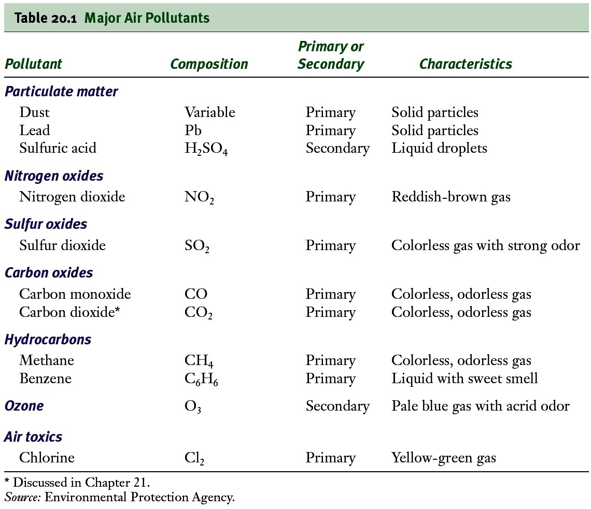
Major Air Pollutants

Slide 14
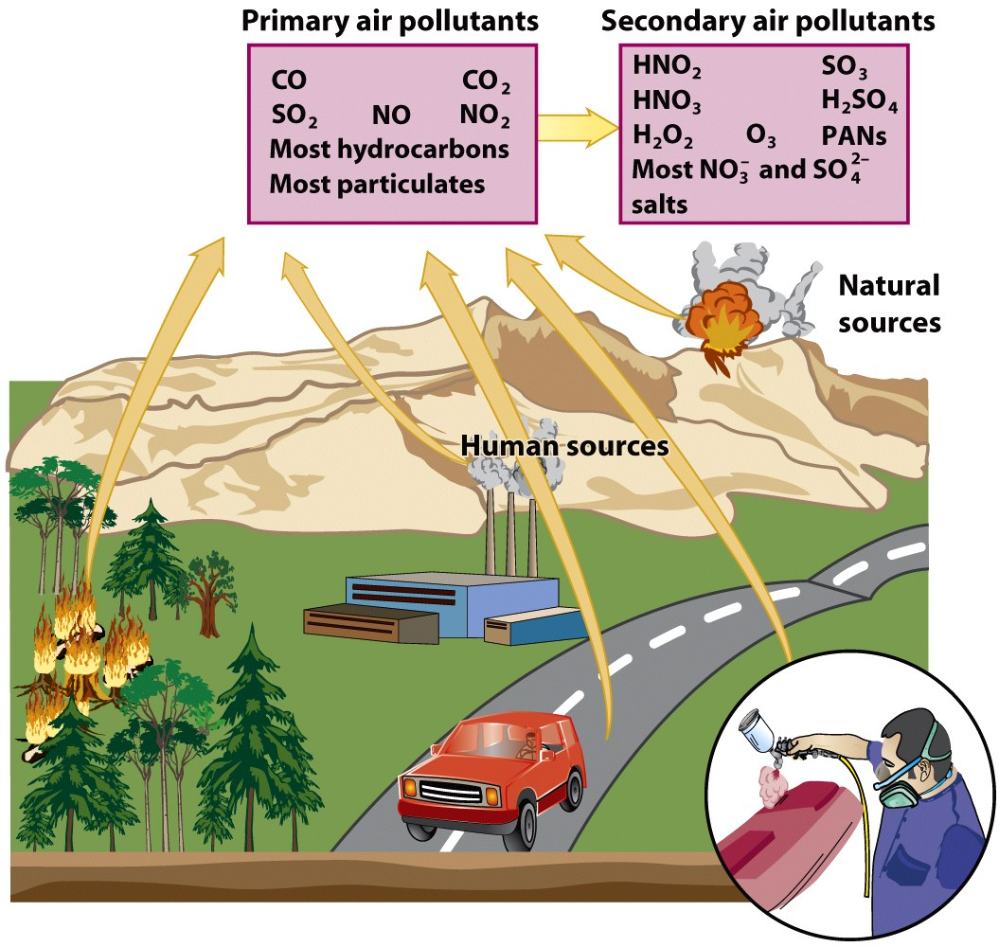

Slide 15
Major Classes of Air Pollutants
Particulate Material
Nitrogen Oxides
Sulfur Oxides
Carbon Oxides
Hydrocarbons
Ozone

Slide 16
Particulate Material
Thousands of different solid or liquid particles suspended in air
Includes: soil particles, soot, lead, asbestos, sea salt, and sulfuric acid droplets
Dangerous for 2 reasons
May contain materials with toxic or carcinogenic effects
Extremely small particles can become lodged in lungs

Slide 17
Nitrogen and Sulfur Oxides
Nitrogen Oxides
Gases produced by the chemical interactions between atmospheric nitrogen and oxygen at high temperature
Problems
Greenhouse gases
Cause difficulty breathing
Sulfur Oxides
Gases produced by the chemical interactions between sulfur and oxygen
Causes acid precipitation

Slide 18
Carbon Oxides and Hydrocarbons
Carbon Oxides
Gases carbon monoxide (CO) and carbon dioxide (CO₂)
Greenhouse gases
Hydrocarbons
Diverse group of organic compounds that contain only hydrogen and carbon (ex: CH₄- methane)
Some are related to photochemical smog and greenhouse gases

Slide 19
Ozone
Tropospheric Ozone
Man- made pollutant in the lower atmosphere
Secondary air pollutant
Component of photochemical smog
Stratospheric Ozone
Essential component that screens out UV radiation in the upper atmosphere
Man- made pollutants (ex: CFCs) can destroy it

Slide 20
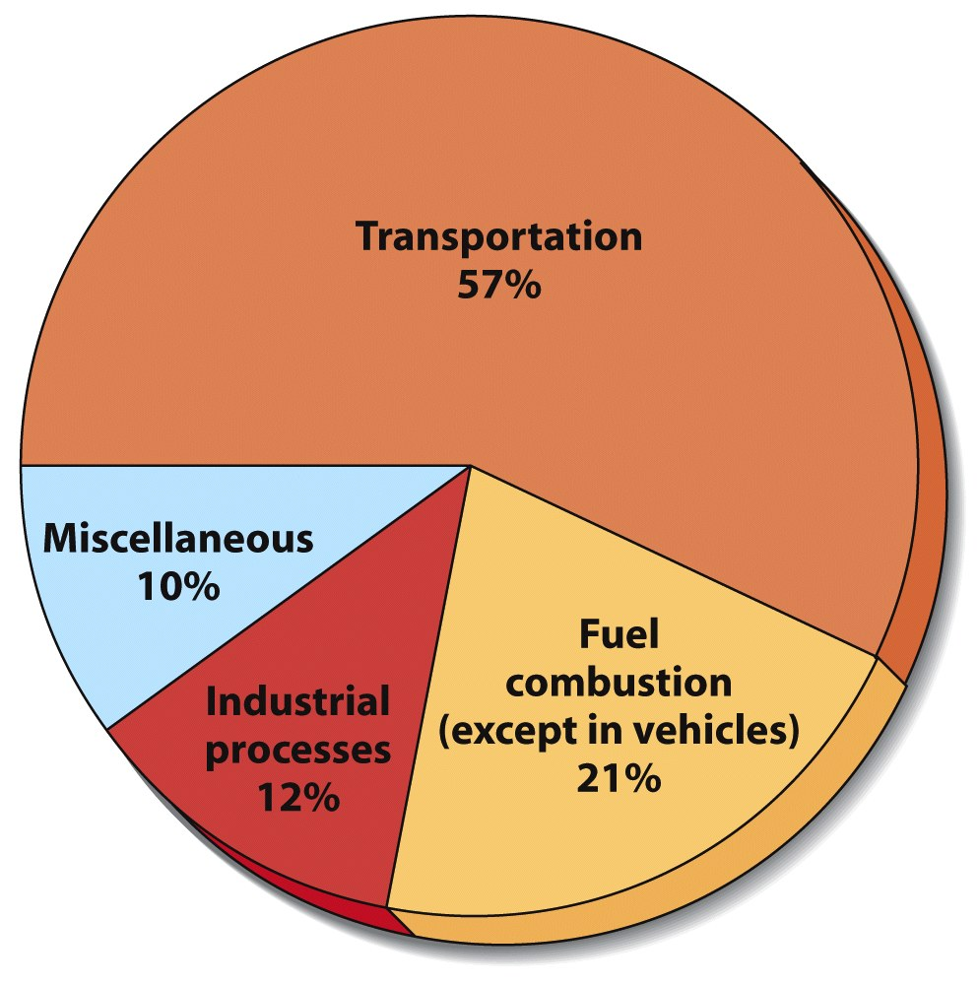
Sources of Outdoor Air Pollution
Two main sources
Transportation
Industry
Intentional forest fires is also high

Slide 21
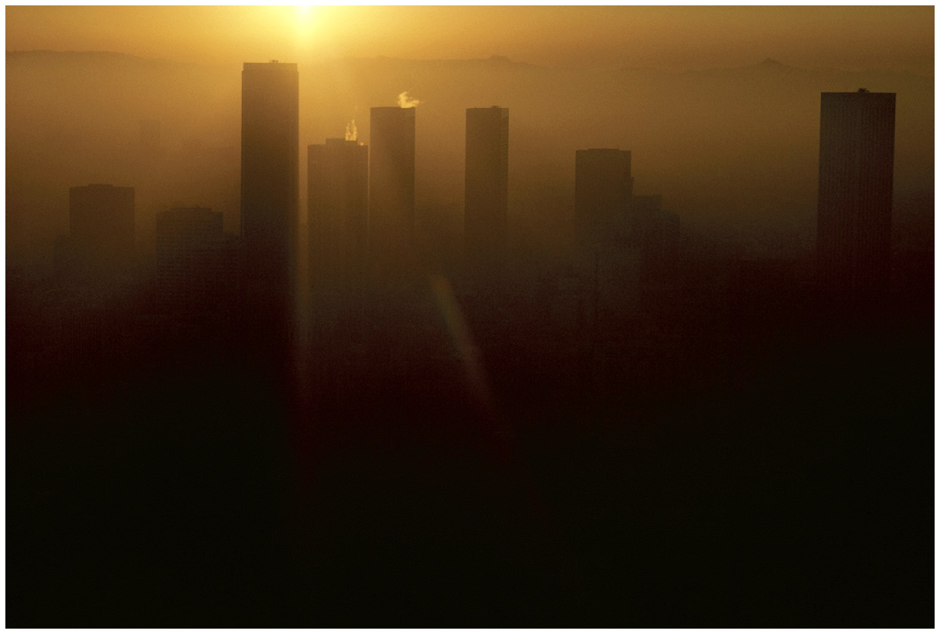
Urban Air Pollution
Photochemical Smog (ex: Los Angeles below)
Brownish-orange haze formed by chemical reactions involving sunlight, nitrogen oxide, and hydrocarbons

Slide 22
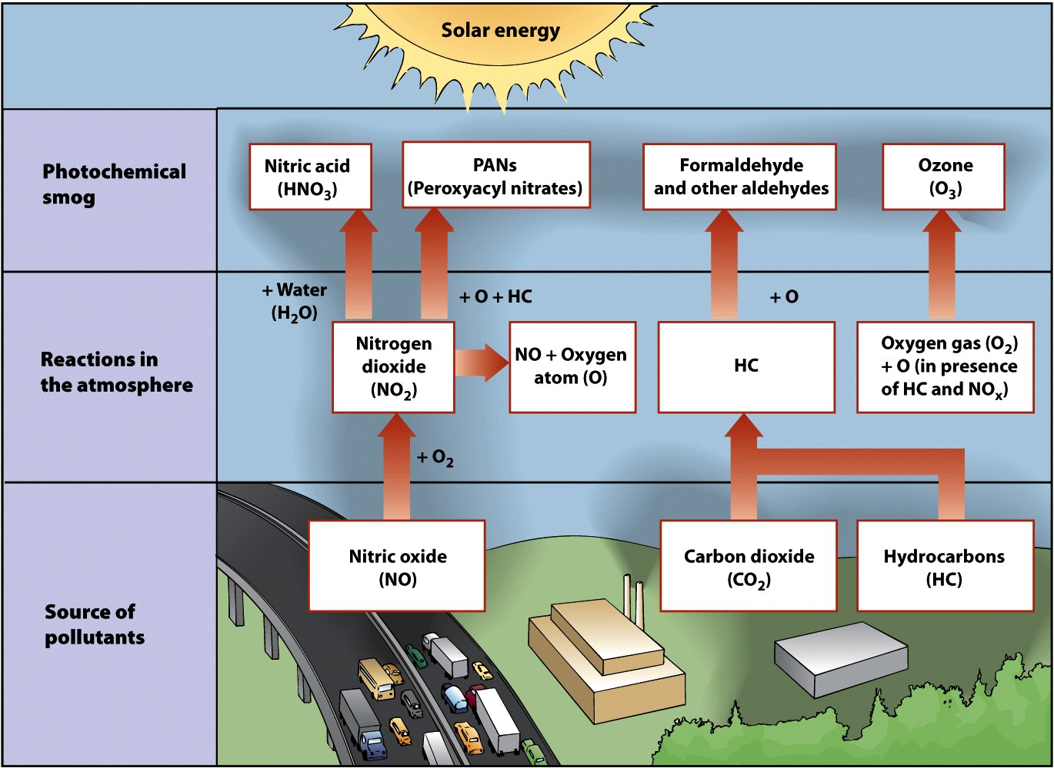
Formation of Photochemical Smog

Slide 23
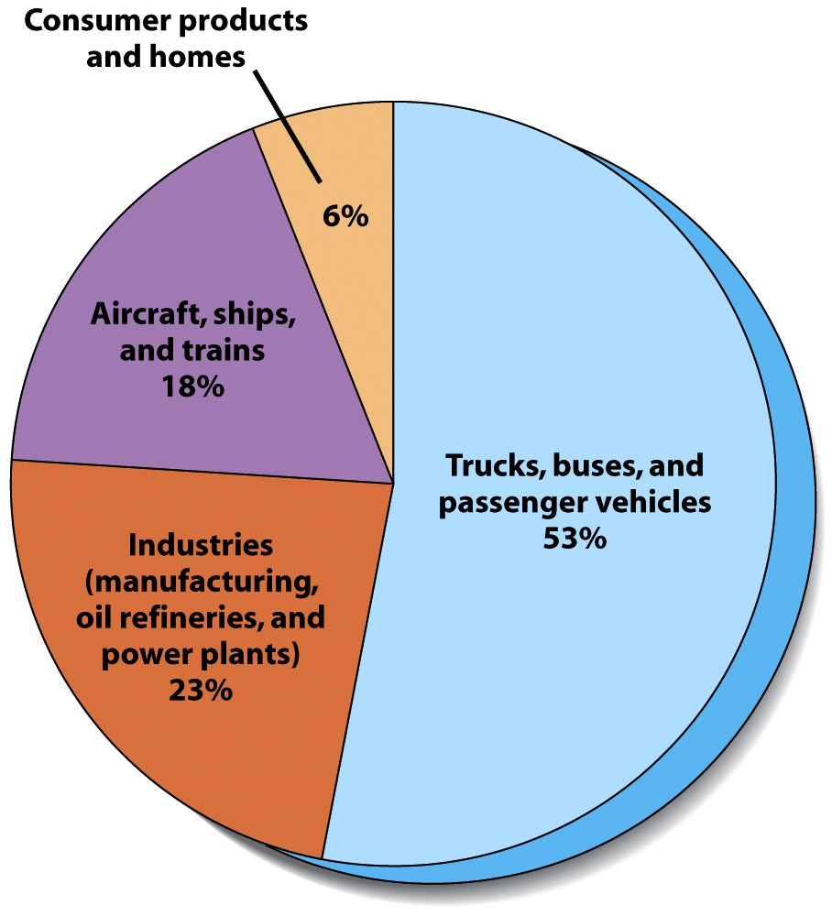
Sources of Smog in Los Angeles

Slide 24
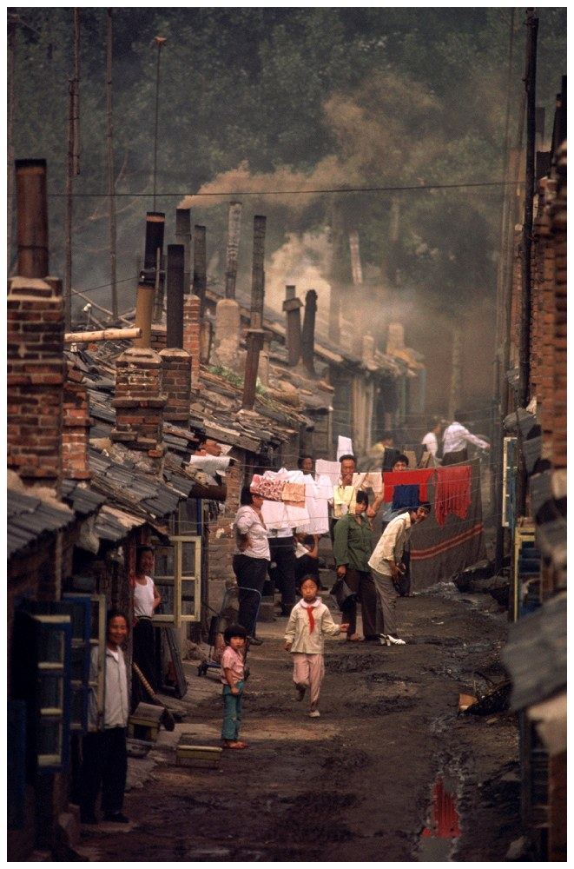
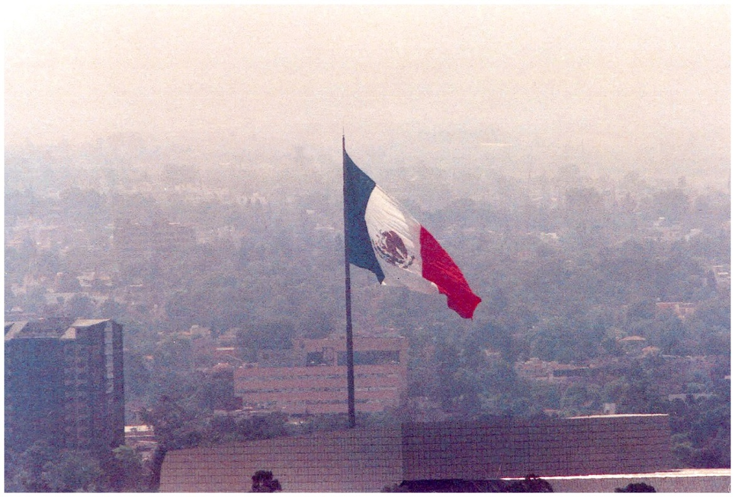
Case-In-Point Air Pollution in Beijing and Mexico City
Beijing (left)
Mexico City (above)

Slide 25
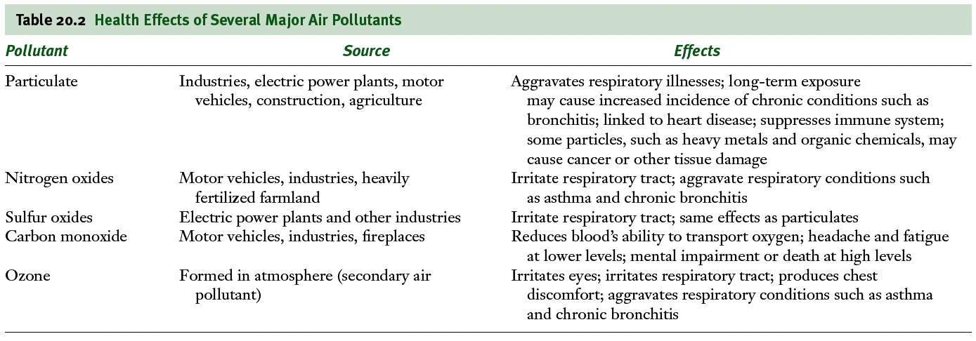
Effects of Air Pollution
Low level exposure
Irritates eyes
Causes inflammation of respiratory tract
Can develop into chronic respiratory diseases

Slide 26
Health Effects of Air Pollution
Sulfur Dioxide and Particulate material
Irritate respiratory tract and impair ability of lungs to exchange gases
Nitrogen Dioxides
Causes airway restriction
Carbon monoxide
Binds with iron in blood hemoglobin
Causes headache, fatigue, drowsiness, death
Ozone
Causes burning eyes, coughing, and chest discomfort

Slide 27
Children and Air Pollution
Greater health threat to children than adults
Air pollution can restrict lung development
Children breath more often than adults
Children who live in high ozone areas are more likely to develop asthma

Slide 28
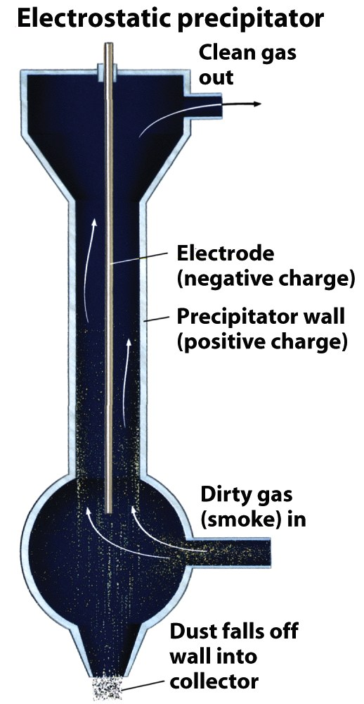
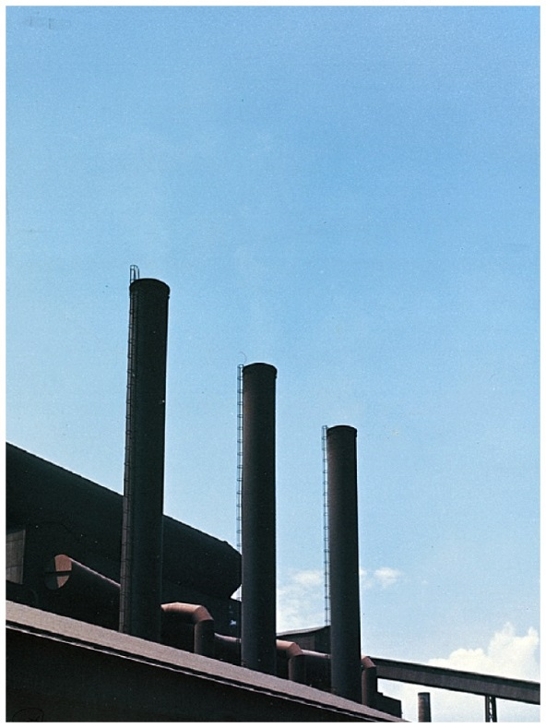
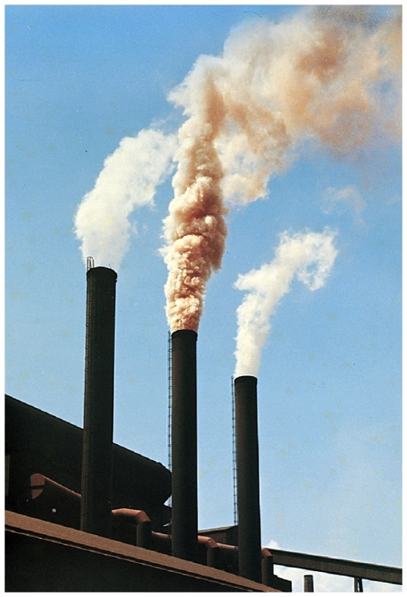
Controlling Air Pollution in US
Smokestacks with electrostatic precipitator (right)
Without Electrostatic precipitator
With Electrostatic precipitator

Slide 29
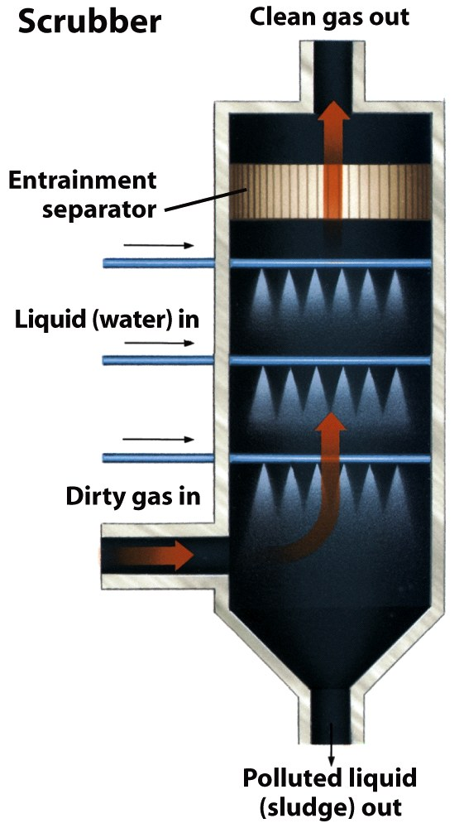
Controlling Air Pollution in the US
Smokestacks with scrubbers (right)
Particulate material can also be controlled by proper excavating techniques

Slide 30
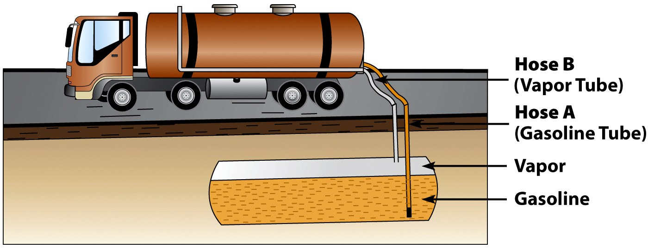
Controlling Air Pollution in the US
Phase I Vapor Recovery System for gasoline

Slide 31
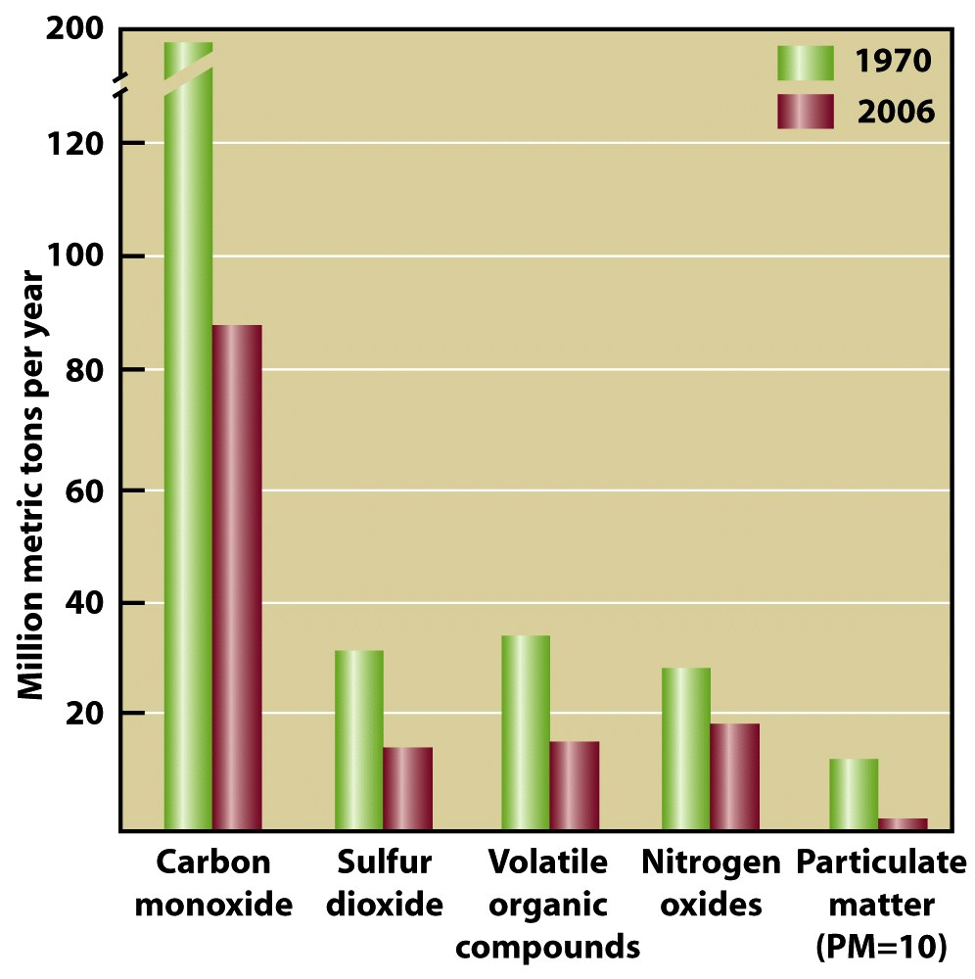
The Clean Air Act
Authorizes EPA to set limits on amount of specific air pollutants permitted
Focuses on 6 pollutants:
lead, particulate matter, sulfur dioxide, carbon monoxide, nitrogen oxides, and ozone
Act has led to decreases!

Slide 32
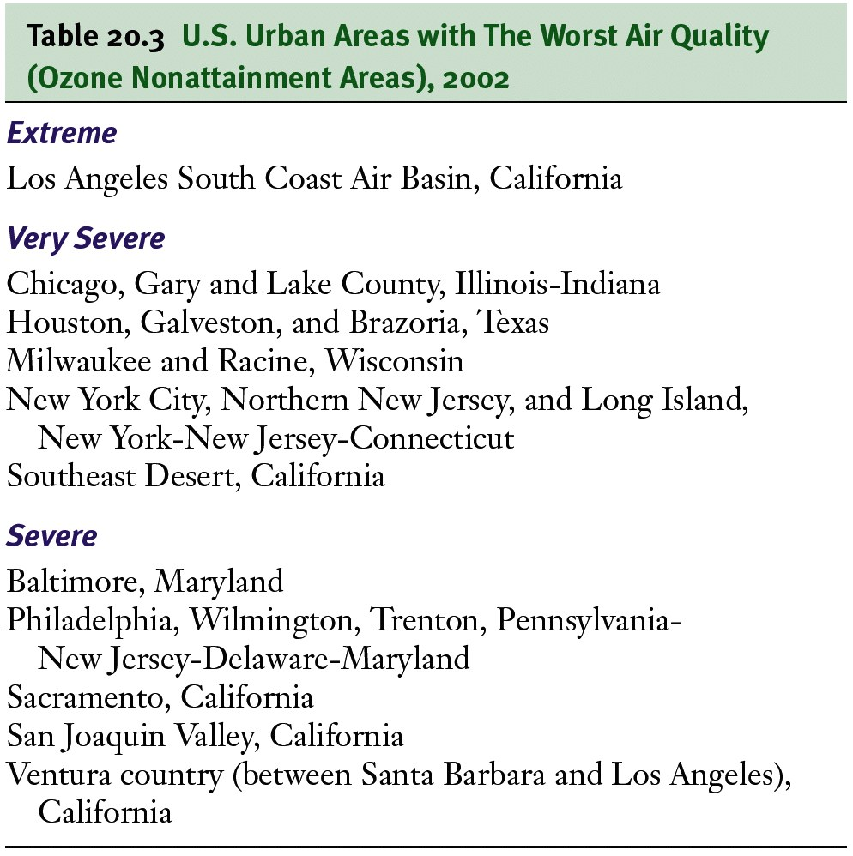

Slide 33
Other Ways to Improve Air Quality
Reduce sulfur content in gasoline from its current average of 330 ppm to 30 ppm
Sulfur clogs catalytic converters
Require federal emission standards for all passenger vehicles
Including SUVs, trucks and minivans
Require emission testing for all vehicles
Including diesel

Slide 34
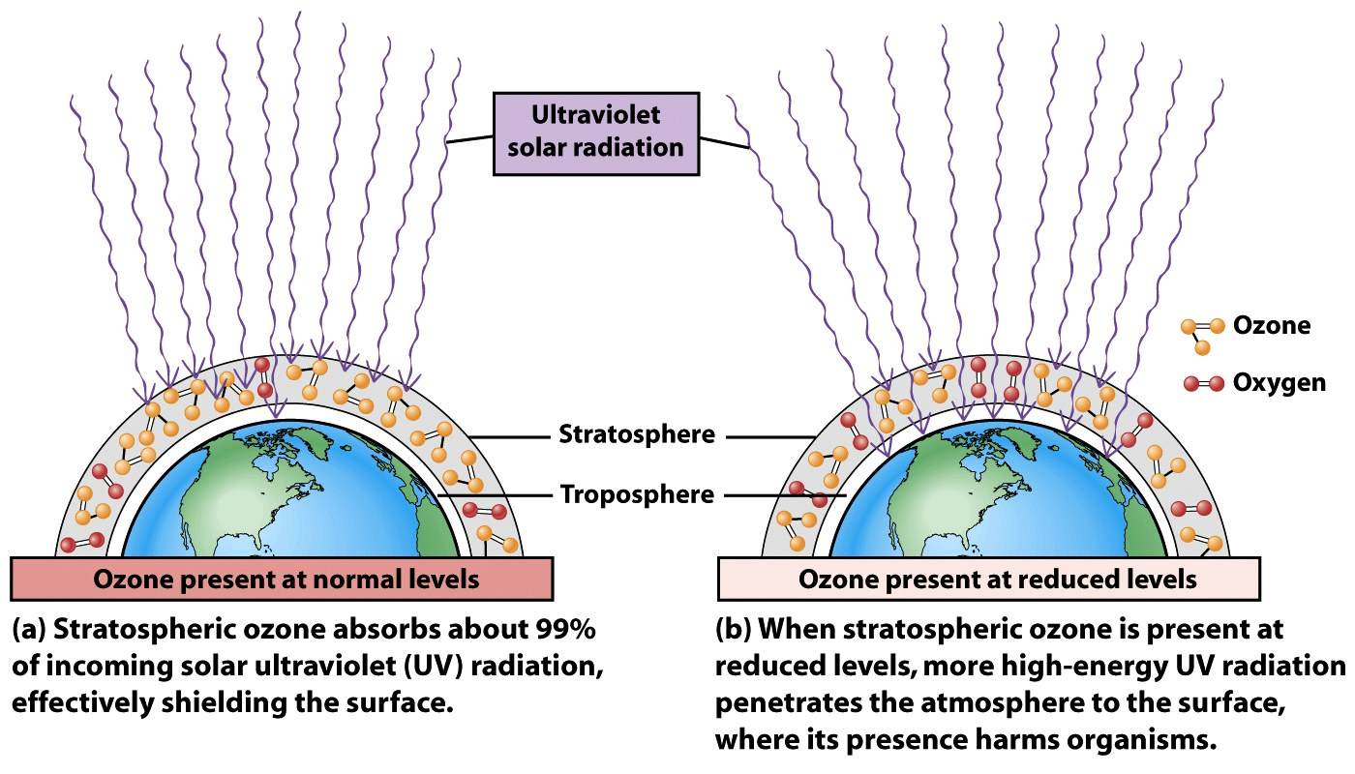
Ozone Depletion in Stratosphere
Ozone Protects earth from UV radiation
Part of the electromagnetic spectrum with wavelengths just shorter than visible light

Slide 35
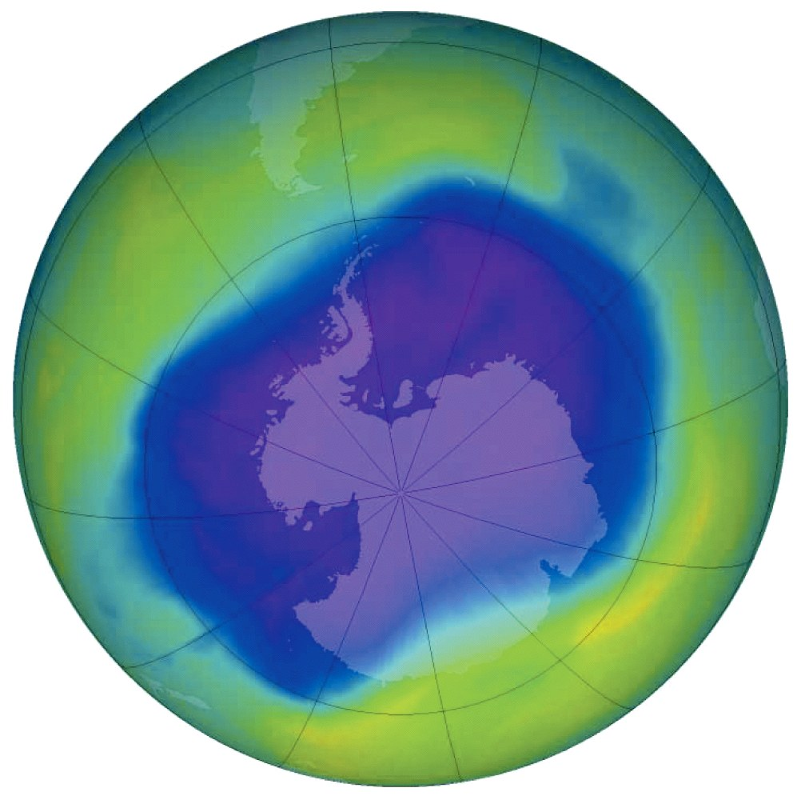
Ozone Depletion in Stratosphere
Ozone thinning/hole
First identified in 1985 over Antarctica
Caused by
human-produced bromine and chlorine containing chemicals
Ex: CFCs

Slide 36
Ozone Depletion in Stratosphere
Hole over Antarctica requires two conditions:
Sunlight just returning to polar region
Circumpolar vortex- a mass of cold air that circulates around the southern polar region
Isolates it from the warmer air in the rest of the planet
Polar stratospheric clouds form
Enables Cl and Br to destroy ozone

Slide 37
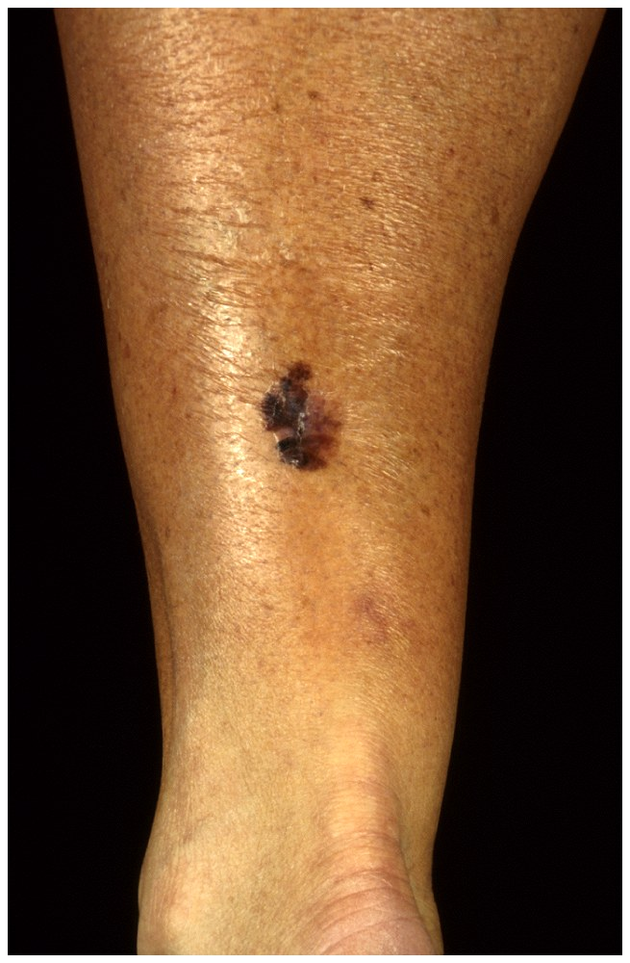
Effects of Ozone Depletion
Higher levels of UV-radiation hitting the earth
Eye cataracts
Skin cancer (right)
Weakened immunity
May disrupt ecosystems
May damage crops and forests

Slide 38
Recovery of Ozone Layer
Montreal Protocol (1987)
Reduction of CFCs
Started using HCFCs (greenhouse gas)
Phase out of all ozone destroying chemicals is underway globally
Satellite pictures in 2000 indicated that ozone layer was recovering
Full recovery will not occur until 2050

Slide 39
Acid Deposition
Sulfur dioxide and nitrogen dioxide emissions react with water vapor in the atmosphere and form acids that return to the surface as either dry or wet deposition
pH scale

Slide 40
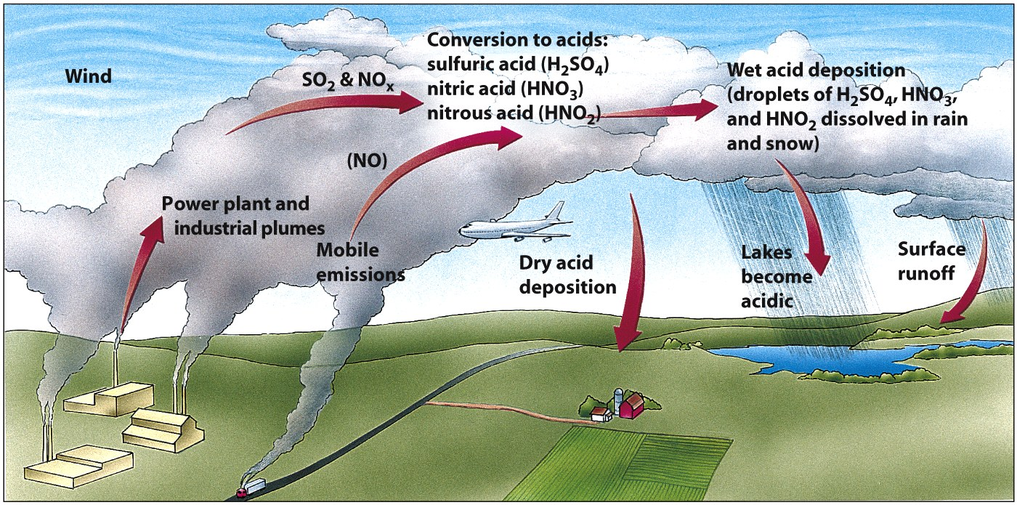
How Acid Deposition Develops

Slide 41
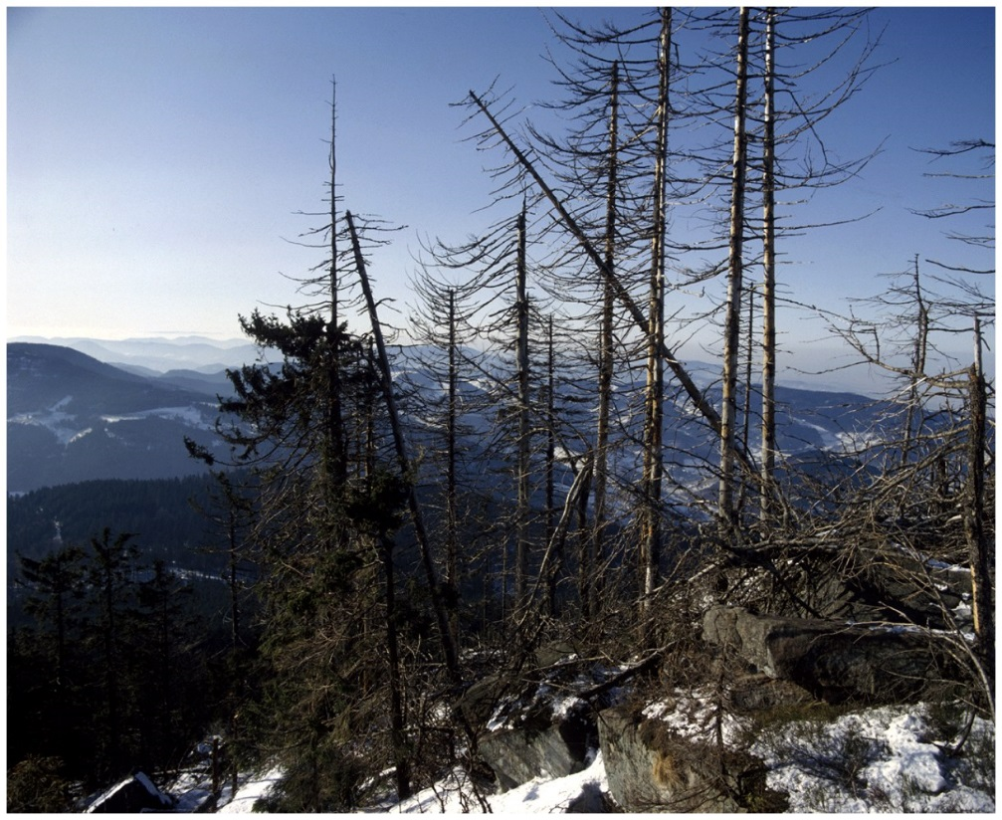
Effects of Acid Deposition
Declining Aquatic Animal Populations
Thin-shelled eggs prevent bird reproduction
Because calcium is unavailable in acidic soil
Forest decline
Ex: Black forest in Germany (50% is destroyed)

Slide 42
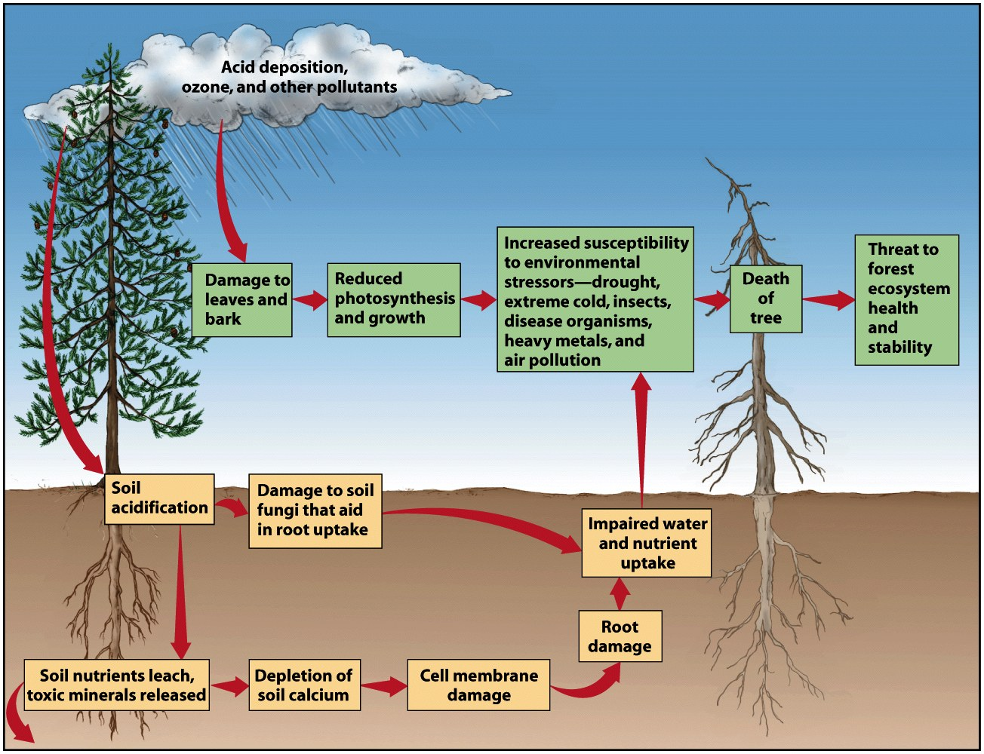
Acid Deposition and Forest Decline

Slide 43
Air Pollution Around the World
Air quality is deteriorating rapidly in developing countries
Shenyang, China
Residents only see sunlight a few weeks each year
Developing countries have older cars
Still use leaded gasoline
5 worst cities in world
Beijing, China; Mexico City, Mexico; Shanghai, China; Tehran, Iran; and Calcutta, India

Slide 44
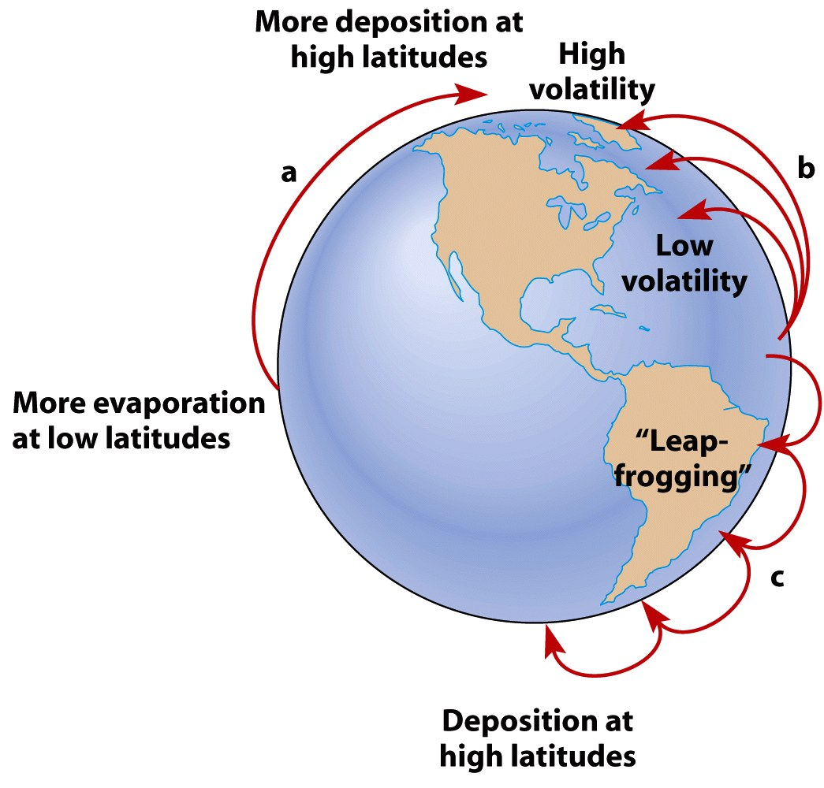
Long Distance Transport of Air Pollutants

Slide 45
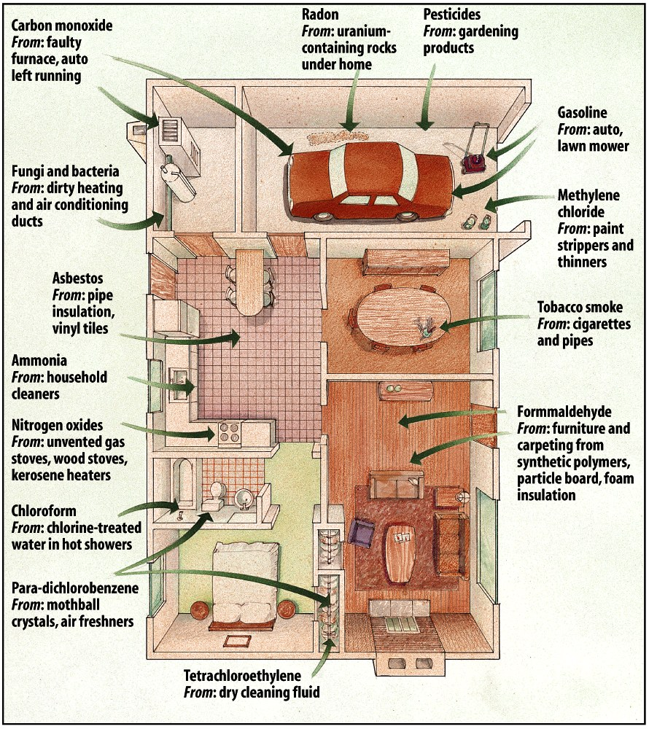
Indoor Air Pollution
Pollutants can be 5-100X greater than outdoors
Most common:
Radon, cigarette smoke, carbon monoxide, nitrogen dioxide, formaldehyde pesticides, lead, cleaning solvents, ozone, and asbestos

Slide 46
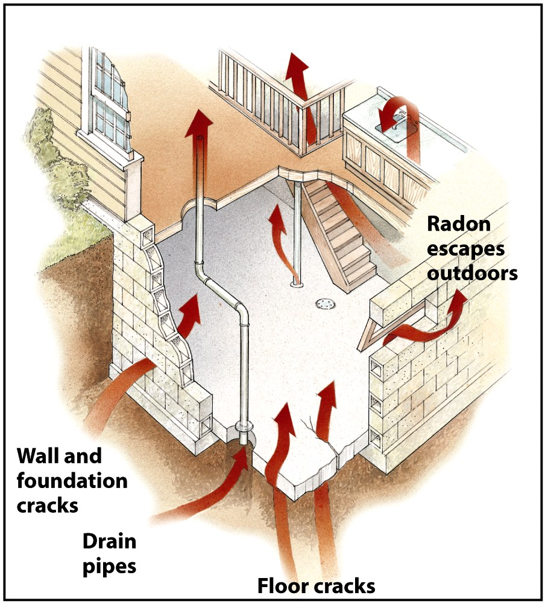
Indoor Air Pollution - Radon

Slide 47
Food and Agriculture

Slide 48
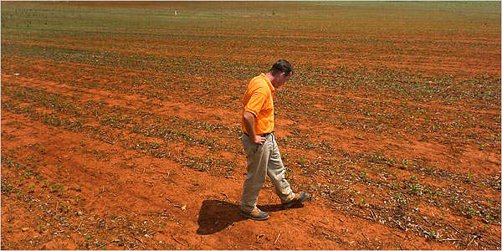
Feeding the World
Catastrophic weather events, such as lack of rain, loss of soil, etc, can result in famine.

Slide 49
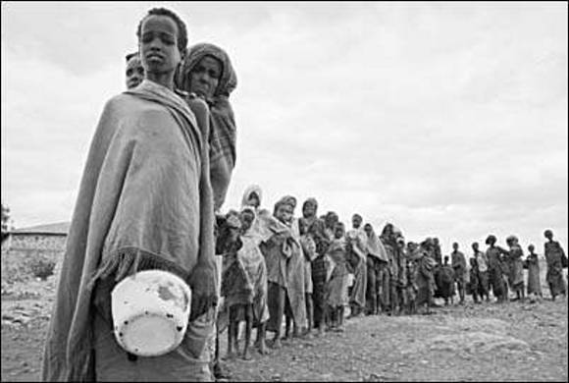
Famine
Widespread starvation caused by a food shortage
War can also contribute to famine

Slide 50
Necessary Nutrients
Nutrient | Food Sources | Function
Carbohydrates | Wheat, corn, rice | Quick energy
Lipids (fats) | Animal fat, nuts, olives | Forms cell membranes, hormones, stored energy
Proteins | Animal food, some plants | Builds and maintains body structures
Need a variety of nutrients
8 essential amino acids
Building blocks of proteins

Slide 51
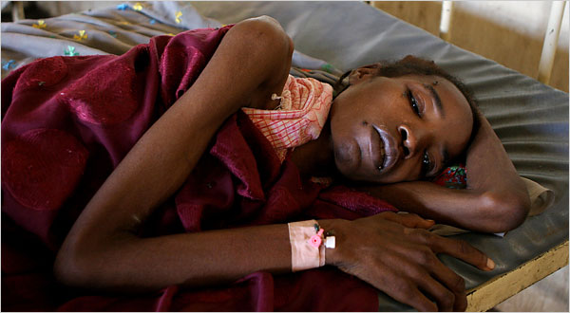
Malnutrition
A condition that occurs when people do not consume enough calories or do not eat a sufficient variety of foods to fulfill all of the body’s needs.

Slide 52
Diet
The type and amount of food a person eats.
Varies by region
People in more developed countries tend to eat more food and larger proportions of proteins and fats.
Some parts of the world only have corn or rice available.

Slide 53
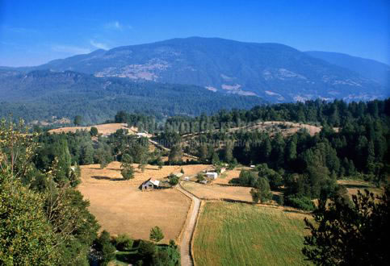
Growing Human Population
As the human population grows, farmland is replacing forests and grasslands
Makes it difficult to maintain natural ecosystems
Different types of agriculture create different environmental impacts

Slide 54
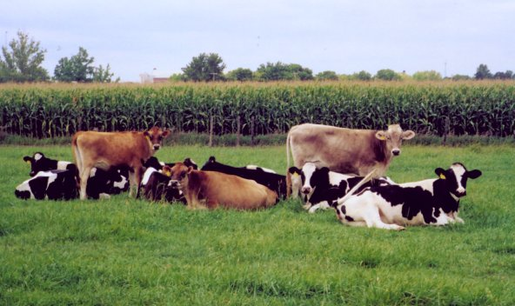
Feeding Many
On average, meat requires more energy, water, and land to produce 1 Calorie of food.

Slide 55
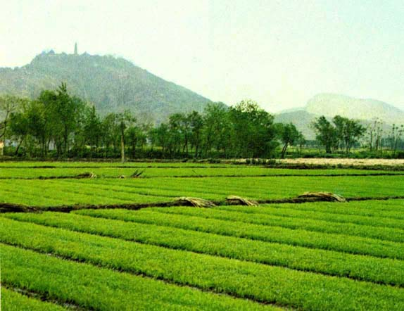
Yield
Amount of food that can be produced in a given area.
A given area of land can usually produce more food for humans when it’s used to grow plants than animals
More energy available
Reason why diets vary
around the world

Slide 56
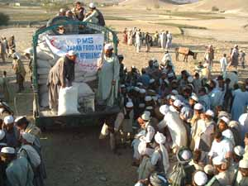
World Food Problems
World food production is no longer increasing a fast as the human population is increasing.
Food is unequally distributed.
Malnutrition is largely a result of poverty.

Slide 57
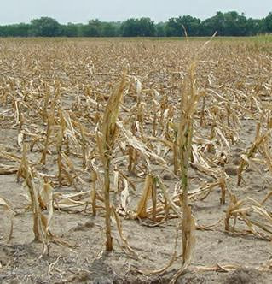
Drought
Droughts in areas without irrigation may not leave seeds to plant crops the following year.
Effect may continue for years.
Long droughts may impact soil and make it less able to support crop production.

Slide 58
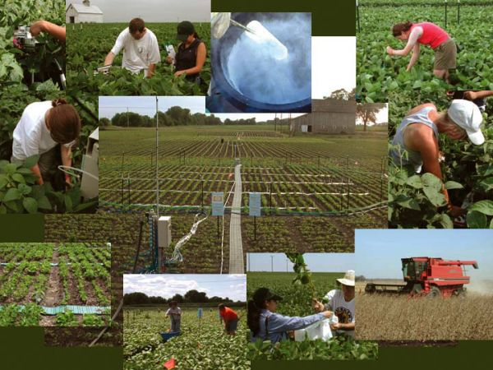
Green Revolution
Increased crop production due to use of new crop varieties and modern agricultural techniques.

Slide 59
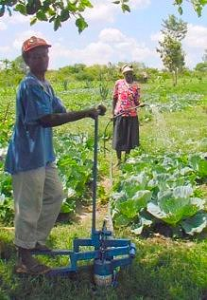
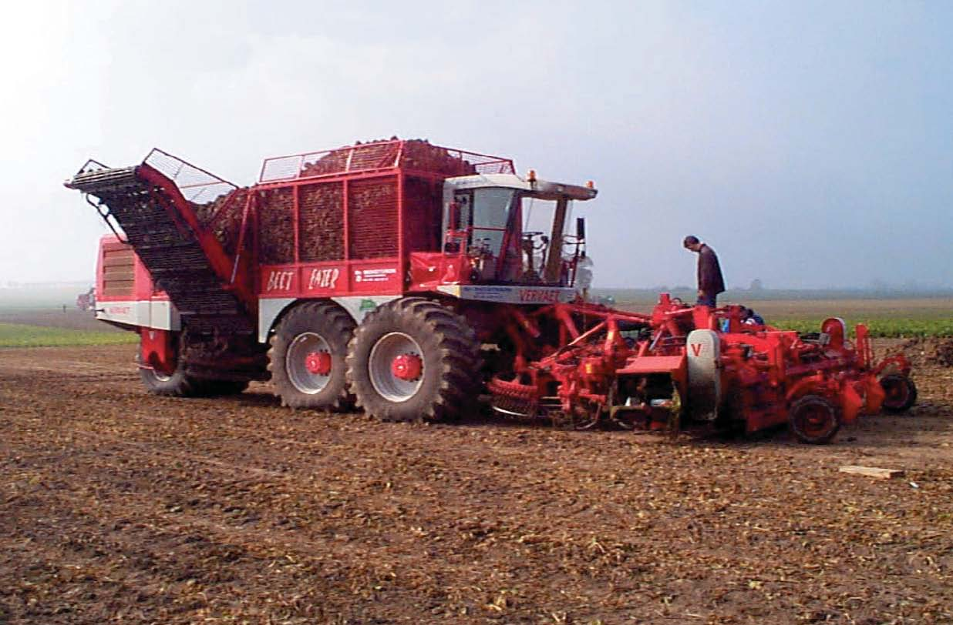
Negatives of the Green Revolution
New crop varieties require large amounts of water, fertilizers, and pesticides.
Machinery, irrigation, and chemicals degrade soil.
Subsistence farmers couldn’t keep up

